Slide 1
Chemical Equilibrium
06/08/2023
Dr. Muhammed Shah Miran
Professor, Department of Chemistry
University of Dhaka, Dhaka 1000

Slide 2
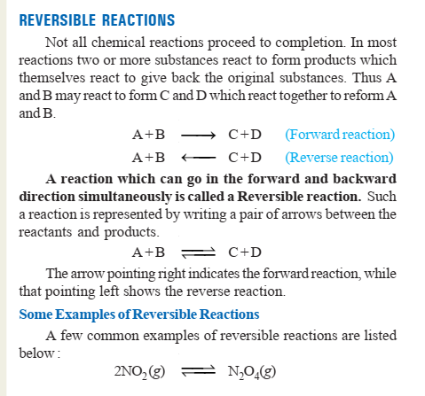

Slide 3
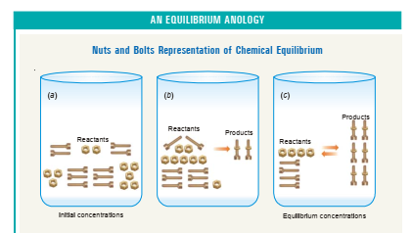

Slide 4
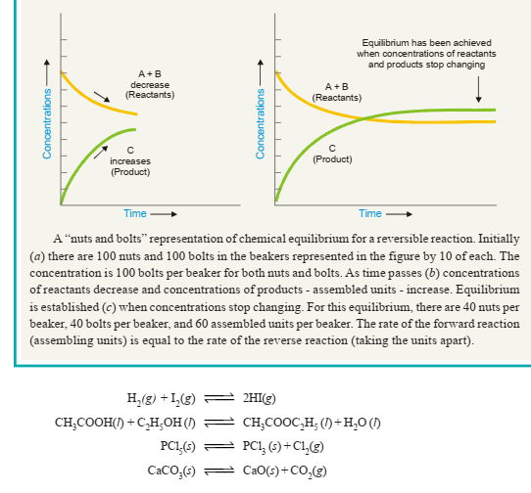

Slide 5
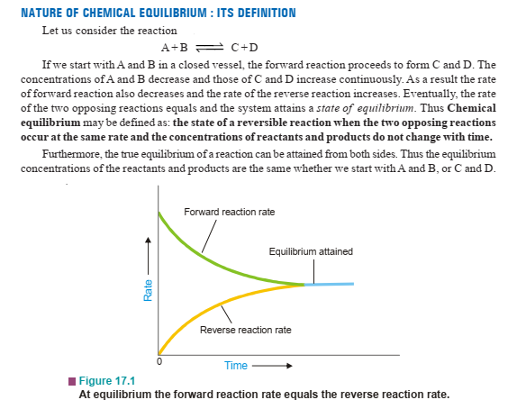

Slide 6
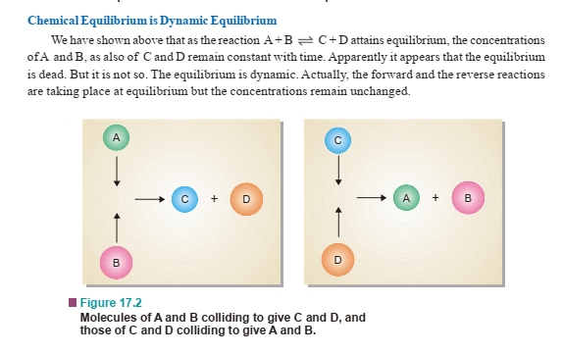
The dynamic nature of chemical equilibrium can be easily understood on the basis of the kinetic molecular model. The molecules of A and B in the equilibrium mixture collide with each other to form C and D. Likewise C and D collide to give back A and B. The collisions of molecules in a closed system is a ceaseless phenomenon. Therefore collisions of A and B giving C and D (Forward reaction) and collisions of C and D giving back A and B (reverse reaction) continue to occur even at equilibrium, while concentrations remain unchanged

Slide 7
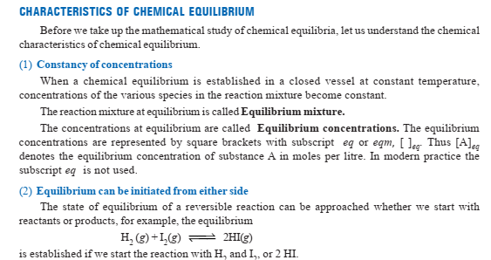

Slide 8
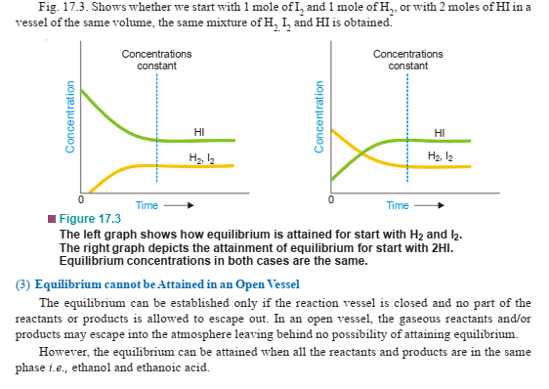

Slide 9
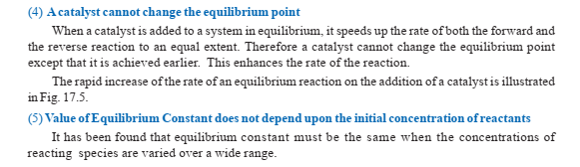


Slide 10
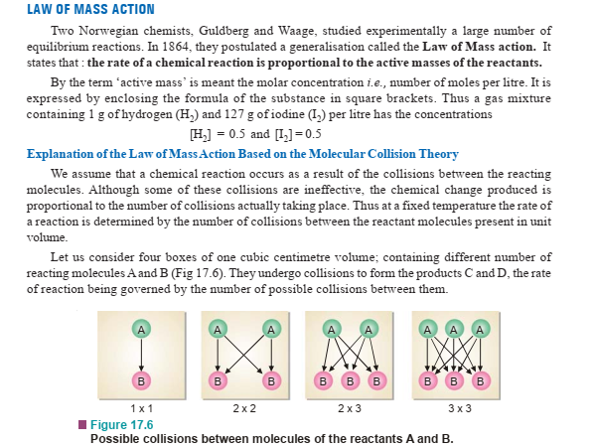

Slide 11
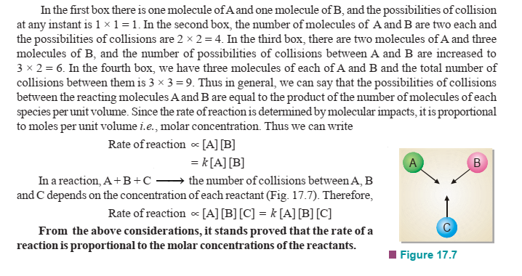

Slide 12
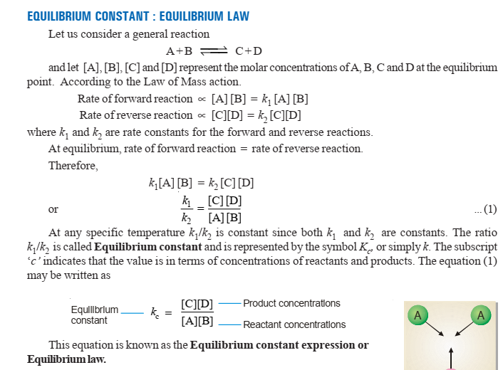

Slide 13
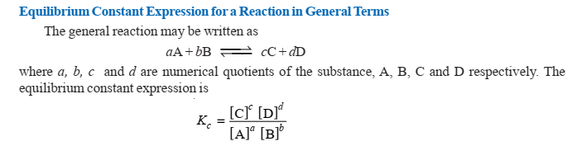

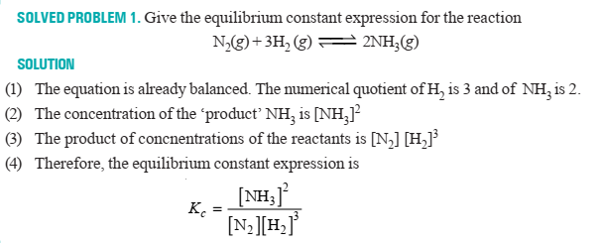

Slide 14
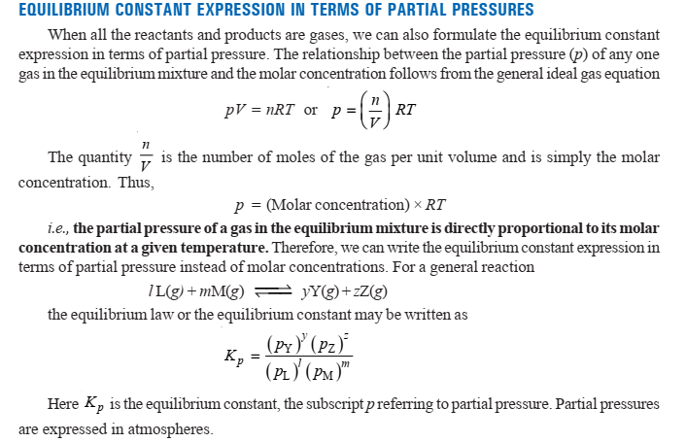

Slide 15
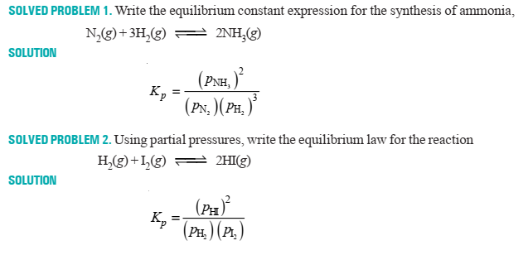

Slide 16
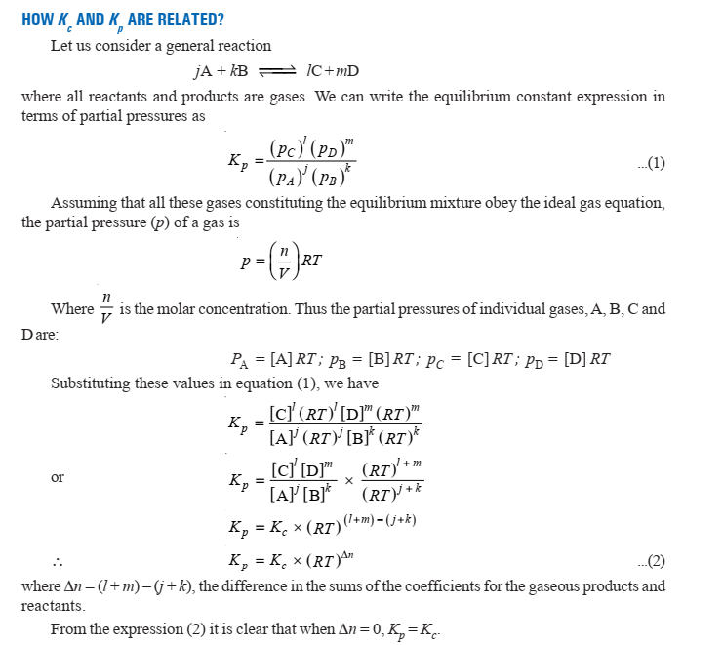

Slide 17
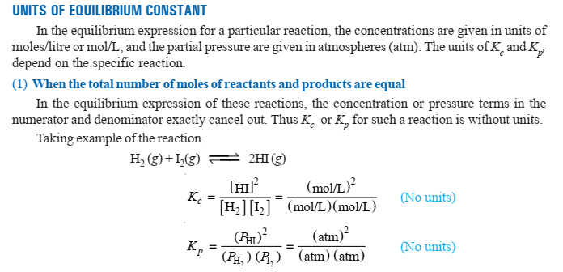
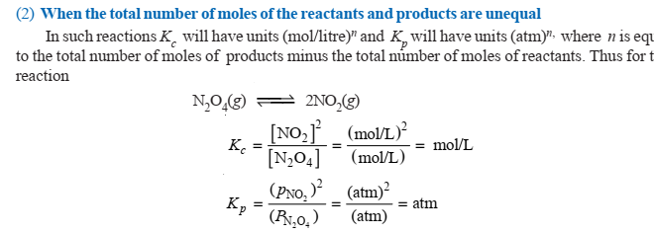

Slide 18
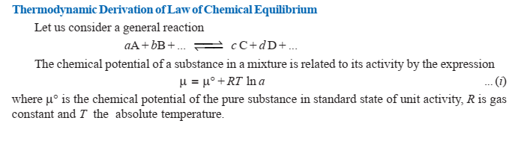
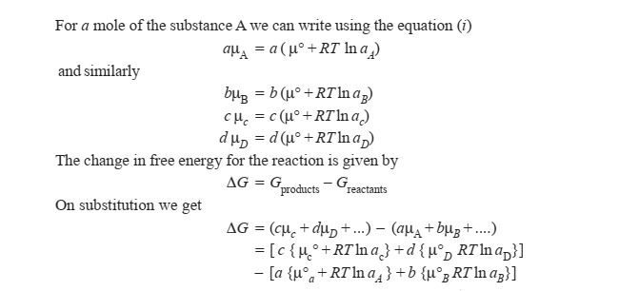

Slide 19
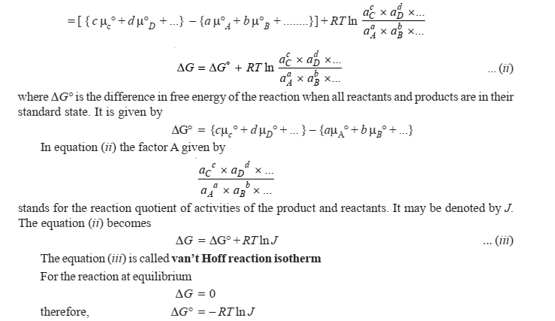

Slide 20
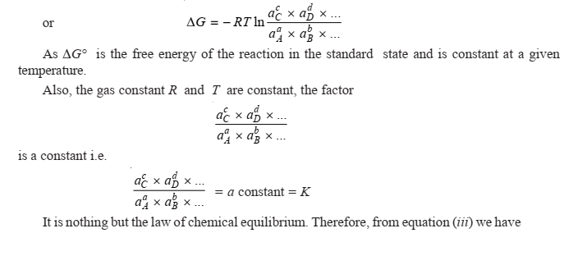
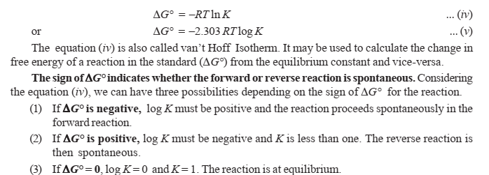
∆G⁰

Slide 21
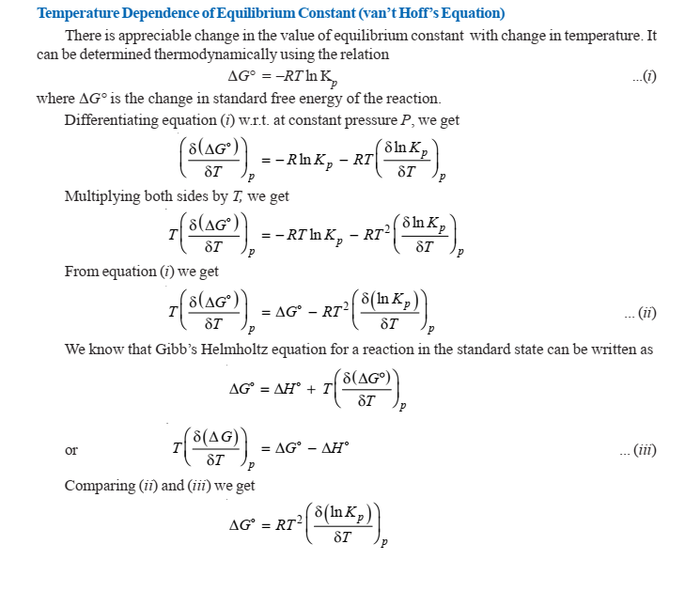

$$∆H0$$

Slide 22
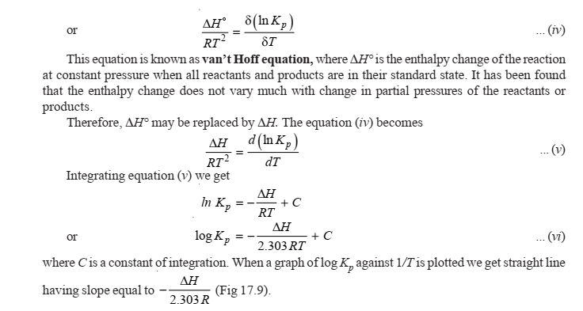

Slide 23
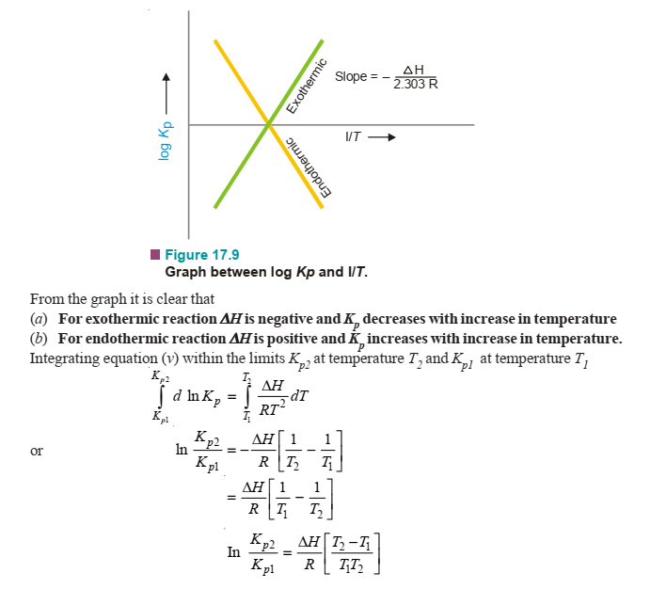
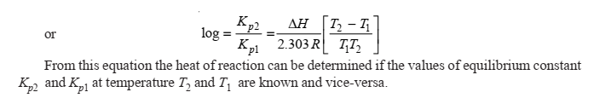

Slide 24
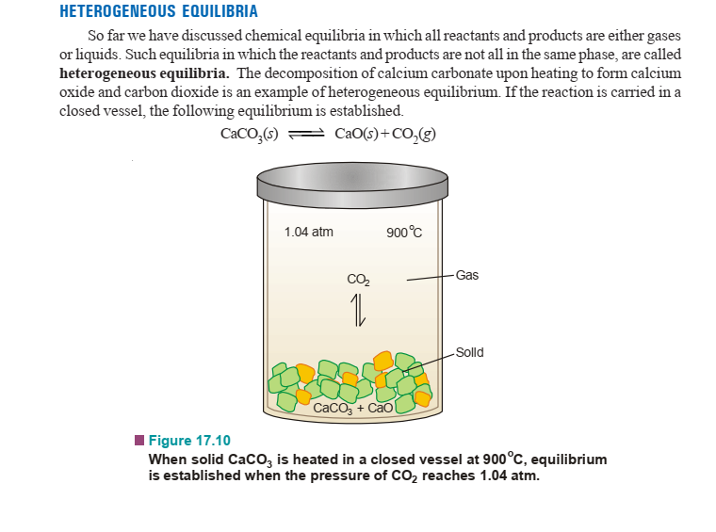

Slide 25
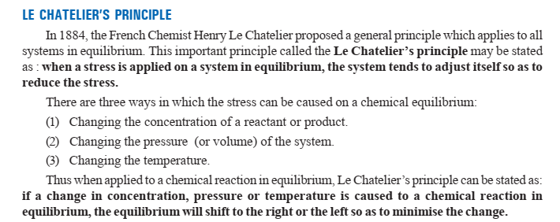
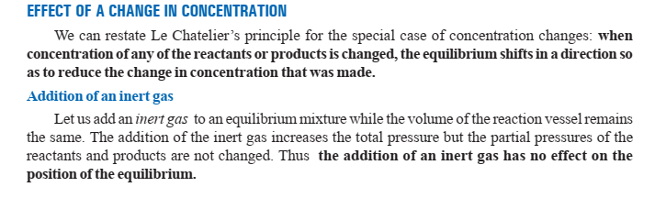

Slide 26
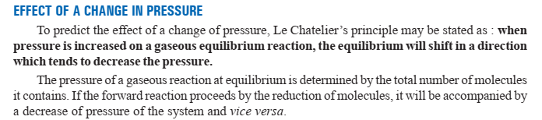
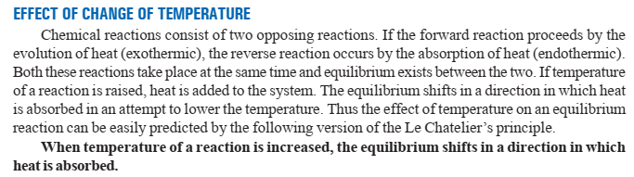

Slide 27
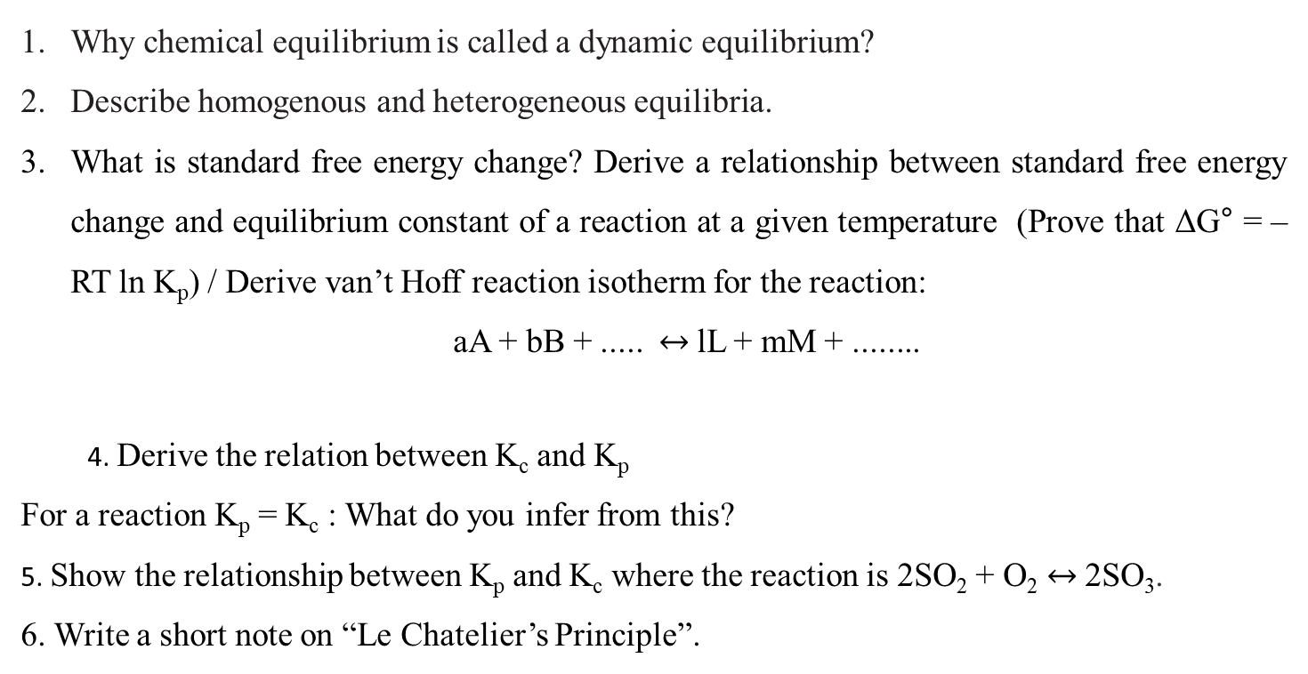
Why chemical equilibrium is called a dynamic equilibrium?
Describe homogenous and heterogeneous equilibria.
What is standard free energy change? Derive a relationship between standard free energy change and equilibrium constant of a reaction at a given temperature (Prove that ΔG° = – RT ln K_{p}) / Derive van’t Hoff reaction isotherm for the reaction:
aA + bB + ..... $↔$lL + mM + ........
4. Derive the relation between K_{c} and K_{p}
For a reaction K_{p} = K_{c} : What do you infer from this?
5. Show the relationship between K_{p} and K_{c} where the reaction is 2SO₂ + O₂ $↔$2SO₃.
6. Write a short note on “Le Chatelier’s Principle”.

Slide 28
SOLVED PROBLEM 1. At 500°C, the reaction between N₂ and H₂ to form ammonia has K_{c} = 6.0 × 10^{–2}. What is the numerical value of K_{p} for the reaction?
SOLVED PROBLEM 2. The value of K_{p} at 25°C for the reaction 2NO(g) + Cl₂ (g) ↔ 2NOCl(g) is 1.9 × 10³ atm^{–1}. Calculate the value of Kc at the same temperature.
SOLVED PROBLEM 1. Calculate K for reaction which has ΔG° value –20 kcal at 25°C.
SOLVED PROBLEM 2. The standard free energy change for the reaction N₂(g) + O₂(g) ↔ 2NO(g) is +173.1 kJ. Calculate K_{p} for the reaction at 25°C.
The equilibrium constant, K_{p} for the reaction C₂H₄(g) + H₂(g) ↔ C₂H₆ (g) is 5.04 × 10¹⁷ atm^{–1} at 25°C. Calculate ΔG°.

Slide 29
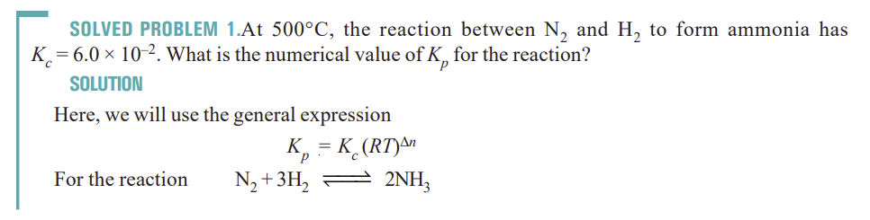
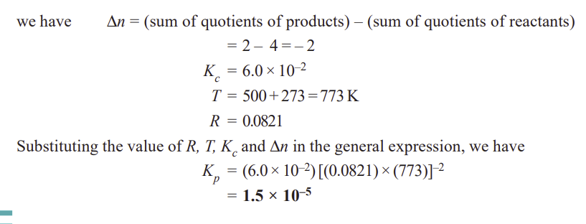

Slide 30
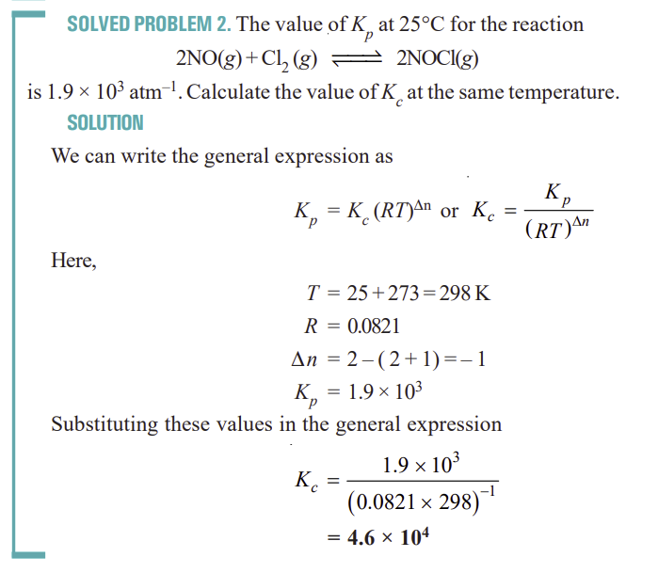

Slide 31
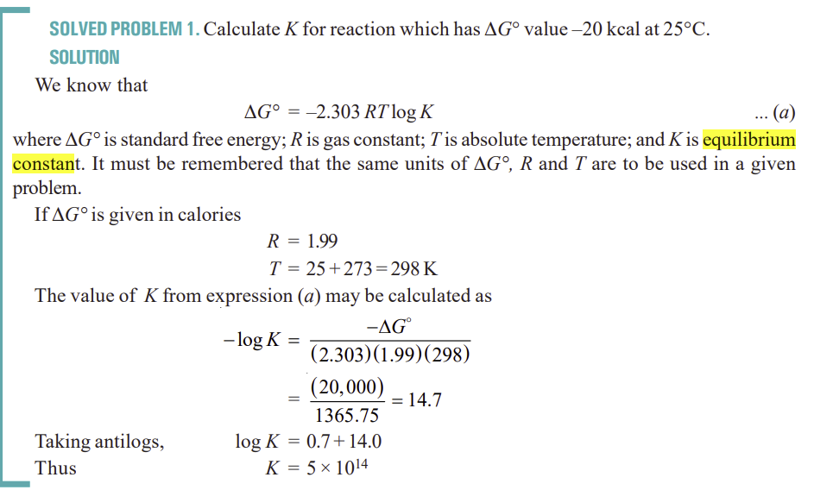

Slide 32
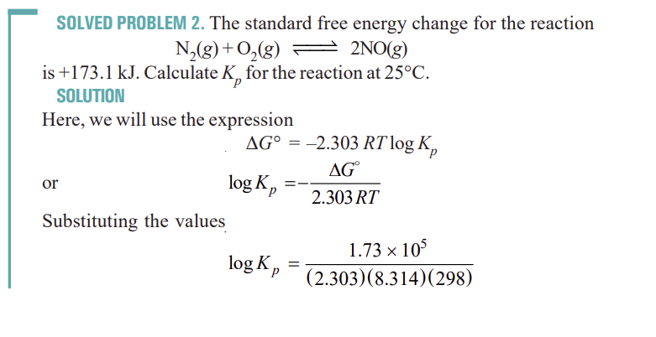
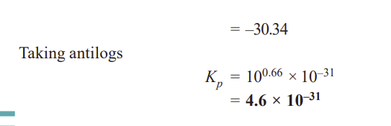

Slide 33
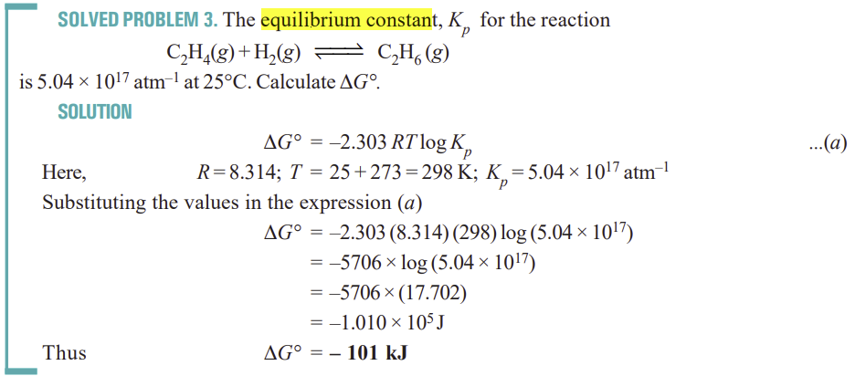

Slide 34
Note:
Please do the solved problems and practice examples.
Follow the reference book: Essential of physical chemistry by Arun Bahl and Tuli.

